Slide 1

UNIT - IV Dominators

Slide 2
Loop
Loop is any cycle in the flow graph of a program
Properties of a loop:
It should have a single entry node, such that al paths from outside the loop to any node in the loop go through the entry.
It should be strongly connected (ie) it should be possible to go from any node of the loop to any other, staying within the loop.

Slide 3
Dominators
The method of detecting loops in the flow graphs is described using the notion of Dominators.
In order to deduct the control flow within basic blocks, it’s required to compute dominators.
In the flow graph consisting a node D and E, if path leaves from D to E, then node D is said as dominating E.

Slide 4
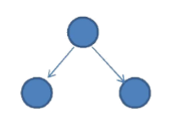
Dominator Tree:
Dominator tree represents the hierarchy of the blocks and its execution flow.
Here, the initial node is taken as the root and every further parent is said to be intermediate dominator of child node.
In above tree, node 1 dominates 2 and 3.

Slide 5
Dominator Tree:
A useful way of presenting dominator information is in a tree called dominator tree, in which the initial node is the root and the parent of each other node is its immediate dominator
Immediate Dominator:
The immediate dominator of ‘n’ is the closest dominator of ‘n’ on any path from the initial node to ‘n’.

Slide 6
Properties of Dominators
The algebraic properties regarding the dominance relation are:
Dominance is a reflexive partial order.
It is
Reflexive { a DOM [a for all a]}
Antisymmetric { a DOM b & b DOM a}
Transitive { a DOM b & b DOM c => a DOM c}
The dominators of each node ‘n’ are linearly ordered by the DOM relation

Slide 7
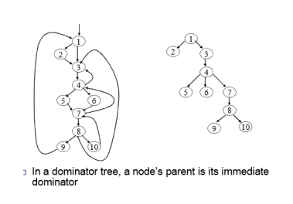
In a dominator tree, a node’s parent is its immediate dominator

Slide 8
Dominator Computing Algorithm
Begin
D(n0) := {n0}
for n in N-{n0} do
D(n) : = N
/* End initialization */
while CHANGE do
Begin
CHANGE : = False
for n in N – {n0} do
Begin
NEWD : = {n} U {∩ D(P)}
If D(n) ≠ NEWD then CHANGE :=True
D(n) := NEWD
End
End
End

Slide 9
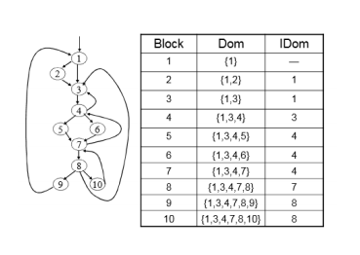

Slide 10
Loop Detection
To look for loops, search for edges in the flow graph whose heads dominate their tools.
(If a→ b is an edge, ‘b’ is the head and ‘a’ is the tail). Such edges are called back edges.
Given a back edge n→d, we can find the natural loop of the edge by finding those nodes that can reach ‘n’ without going through ‘d’.
These nodes plus ‘d’ itself form the loop. Node ‘d’ is the header of the loop.

Slide 11
Algorithm for constructing natural loops
Input : A flow graph G and a back edge n→d
Output : The set LOOP consisting of all nodes in the natural loop.
Method:
A familiar stacking algorithm is used to consider each node ‘m’ in loop, other than ‘d’, to make sure that m’s predecessors are also placed in LOOP.
Each node in LOOP, except for ‘d’ is placed once on STACK, so its predecessor will be examined.

Slide 12
Procedure INSERT(m)
If ‘m’ is not in LOOP then
Begin
LOOP : = LOOP U {m};
push m onto stack;
End;
STACK := empty;
LOOP := {d};
INSERT(n);
While STACK is not empty do
Begin
Pop m, the first element off the stack
For each predecessor ‘p’ of ‘m’ do INSERT(P)
End

Slide 13
Thank you

